Slide 1
RISC-V Security Nov 2021

Slide 2
Intrinsic Security
Zero Trust Model
Root of Trust and Secure Boot
Standards and Certification
Security Ecosystem
Confidential Computing
Isolation
Attestation
Secure Storage
Life Cycle Management
Identity
Security as a basic feature of HW, SW Firmware
Support security through entire lifecycle
Guidelines matched to profiles

Slide 3
RISC-V Security Rationale
Clean-slate architecture invites new hardware security solutions
Open security model accelerates hardware security innovation
Opportunity to incorporate security industry learnings & best practices
Open governance facilitates collaboration on best security approach
Royalty free model enables new open-source hardware security solutions

Slide 4
RISC-V Security Scope
Security Model
Security Ecosystem
Memory Safety
Microarchitectural side channels
Robustness
Cryptography
Isolation & TEEs
Confidential Compute
Blockchains
Security Issues & Response (SIRT)

Slide 5
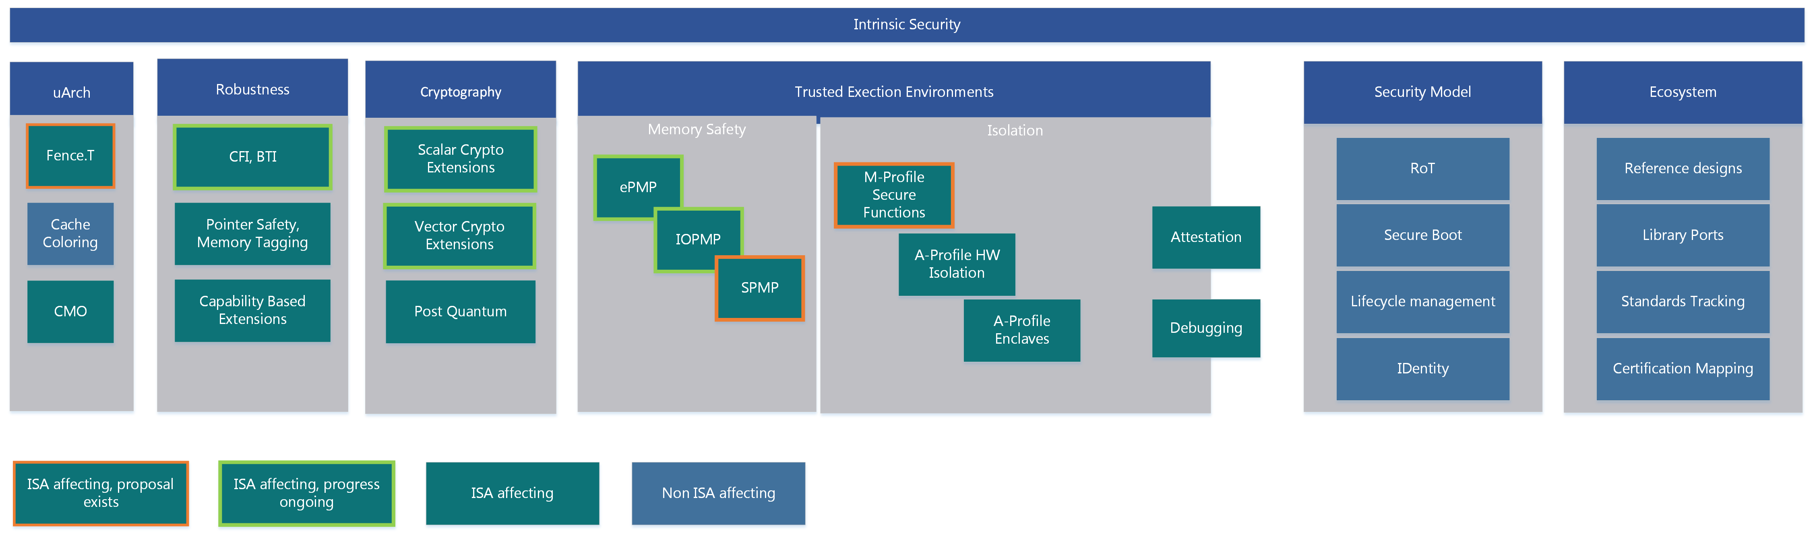

Slide 6
Security Model
State Goals & Rationale for RISC-V Security
Defines scope
Derives security requirements
Abstracted from implementation specifics
References existing standards when appropriate
Referenced by appropriate sections of Platform specifications
By Profile, By Vertical

Slide 7
Security Model
Guiding Principle
Intrinsic security
Zero-Trust
Outline:
Scope, Goals, and Guiding Principles
Security Concerns
Threat Model
Security Topics
Topics:
Lifecycle
Platform Integrity
Data Integrity
Isolation
Secure Boot
Assurance & Attestation
Secure storage
Cryptography
Applicable Standards

Slide 8
Security Ecosystem
Enablement of RISC-V security services & software
Identify and list key open-source security software and libraries
Develop RISC-V security reference implementation(s)
Identify, monitor, and influence applicable standards
Identify and liaison with applicable Security Certification entities

Slide 9
Security Ecosystem
Security Services
Reference implementations
Secure Boot
Attestation
…
Optimised library ports
OpenSSL
mbed Crypto
OS ports
APIs, Calling Conventions
Standards and Certification
Formal Security Proofs
Certification mapping
Verticals
Any Specific requirements ?

Slide 10
Memory Safety
Define strategy for memory protection at the ISA level
Identify improvements that enhance memory security in RISC-V systems
Develop and maintain specifications / ISA extensions for memory safety

Slide 11
uArchitectural Side Channels
Understand how the microarchitecture is vulnerable to information leakage
Identify potential side-channel and covert-channel information leakage
Develop strategy to prevent microarchitectural information leakage in RISC-V systems
Develop and maintain specification/recommendations that mitigate microarchitectural side channels

Slide 12
Leakage Protection
Speculation Barriers
ISA extensions to control uArch ?
Fence.t

Slide 13
Robustness
Understand how malicious actors manipulate and exploit (unexpected) system behavior
Identify capabilities that improve system level robustness under adversarial conditions
Define strategy that will improve robustness of RISC-V systems at ISA or non-ISA level
Develop, maintain, or support creation of specifications as needed

Slide 14
Robustness
Control Flow Integrity
BTI, Shadow Stack, PAC etc
Capability Based
CHERI JWG
Alternatives ?

Slide 15
Cryptography
Understand the landscape of cryptographic schemes and threats against established cryptography
Identify what cryptographic primitives, constructs, and algorithms are in-scope for RISC-V
Develop and maintain crypto related specifications

Slide 16
Isolation & TEEs
Identify what technologies enable isolation and Trusted Execution Environments (TEEs)
Define how isolation/TEEs can be implemented on RISC-V systems
Create gap analysis to identify missing components
Develop, maintain, or support creation of specifications for Isolation/TEEs

Slide 17
Trusted Execution
Memory Safety
PMP based TEEs
Hardware based Isolation
M-Class secure functions
A-Class Maintaining privilege levels in TEE
System Awareness
Attestation of entire software chain from initial boot
Security aware Debugging
Maybe ISA affecting / ISA Affecting

Slide 18
Confidential Compute
Survey technologies or technology stacks used in Confidential Compute
Define requirements that enable Confidential Compute on RISC-V systems
Create technology gap analysis for RISC-V
Develop, maintain, or support creation of specifications as needed

Slide 19
Enclaves
Confidential Compute
Mutually untrusted applications
Isolated Application Enclaves
Encrypted Enclaves
Maybe ISA affecting / ISA Affecting

Slide 20
Blockchains
Define requirements for enabling blockchains/distributed ledgers on RISC-V systems
Identify and address RISC-V technology gaps in enabling distributed ledger technologies
Create use cases and developer guidelines for deploying blockchains/distributed ledgers on RISC-V systems

Slide 21
SIRT
Ensure continuity of the RISC-V Security Incident Response Team (SIRT)
Institute and manage a responsible disclosure process
Triage incoming security disclosures
Maintain a catalogue of security issues

Slide 22
Competition

Slide 23

Competition
Feature |  | arm | intel
Comprehensive Ecosystem |  | Standard Security APIs Open Firmware Reference Implementations Security Model | Standard Security APIs Reference Implementations
Trusted Execution Environment | PMP based TEE (no isolation at m-mode) | Trustzone A class HW TEE Trustzone M class HW TEE
Confidential Compute |  | v9A Realms - Confidential Compute Architecture | SGX Enclaves - Confidential Compute Architecture
Arbitrary Privileged Code Execution | ePMP | Privilege Access Never | SMAP/SMEP
Control Flow Integrity |  | Branch Target Indentifier Pointer Authentication Code | Indirect Branch Tracking Shadow Stack
Memory Safety | ePMP | Memory Tagging Extension
MicroArchitectural Leakage |  | Speculation Barriers | Speculation Barriers
Cryptography | AES, SHA2, SM3, SM4, entropy, Data Independent Execution Latency | AES, SHA2, SHA3, SM3, SM4, RNG, Vector | AES, SHA, RNG, ???
Crypto library |  | AArch64cryptolib | Intel IPP Cryptography

Slide 24
Status

Slide 25
2021 Highlights
New Chair and Vice-Chair (mid-year)
ePMP specification ratified
Crypto Scalar specification ratified
PSIRT process defined
MPU Draft specification
New SIGs: Blockchain, CFI, and uArchitectural Side Channel
Refocused & renamed the Security Tech SIG
IOPMP effort launched under Software HC

Slide 26
1st Half 2022 Targets
Competitive gap analysis & Roadmap
PSIRT process integration & communication
Draft Security Model
Blockchain SIG strategy recommendations
CFI SIG strategy recommendations
uArchitectural Side Channel SIG strategy recommendations
Memory Safety SIG creation
Crypto Vector specification
Russian Crypto TG disposition

Slide 27
Roadmap

Slide 28
Roadmap
Security Model
CFI
HW TEE
Confidential Compute
IOMMU collaboration
IOPMP
ePMP ratified
MPU spec
Russian Crypto
Scalar Crypto ratified
Vector Crypto spec
PQC Crypto spec
MicroArchitectural Leakage
Ecosystem, Reference implementations
2021
2022
2023

Slide 29
Longer Term Priorities
TEE and Confidential Computing
Ecosystem
uArch leakage and CFI protections

Slide 30
backup

Slide 31
Security Organization

